Slide 1

Natural Language Processing using R
Naveen Kumar Kaveti, Data Scientist

Slide 2
Agenda
Introduction to R and RStudio
Applications of R
Reporting using R
Introduction to NLP (Natural Language Processing)
Applications of NLP
Classifying Amazon Reviews

Slide 3
How to install R and RStudio
Download latest version of RStudio here
Follow the instruction steps and install RStudio
Download latest version of R here
Follow the instruction steps and install R

Slide 4
Applications in R
Statistical Computing
Descriptive measures
Sampling distributions
Testing of hypothesis
Linear regression
Logistic regression
ANOVA
Data Science / Machine Learning
Predictive models
Forecasting models
Clustering
Recommendation engine
Text analysis
Recently R is using for training deep learning models like image classification, object detection etc. but this is still in development phase

Slide 5
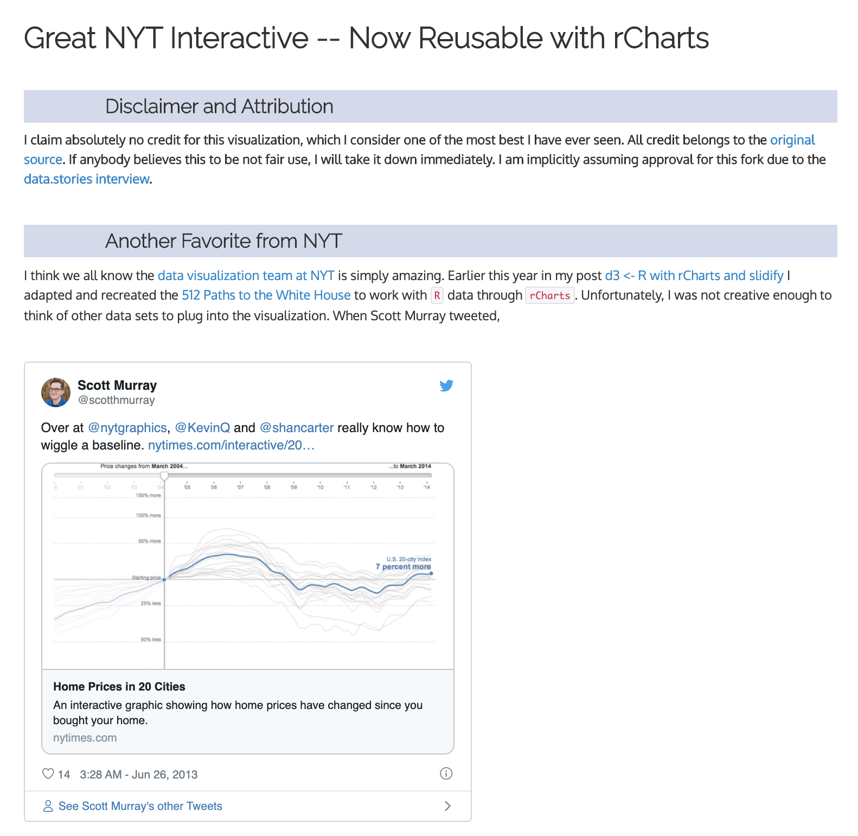
Reporting in R - RMarkdown
Rmarkdown Gallery

Slide 6
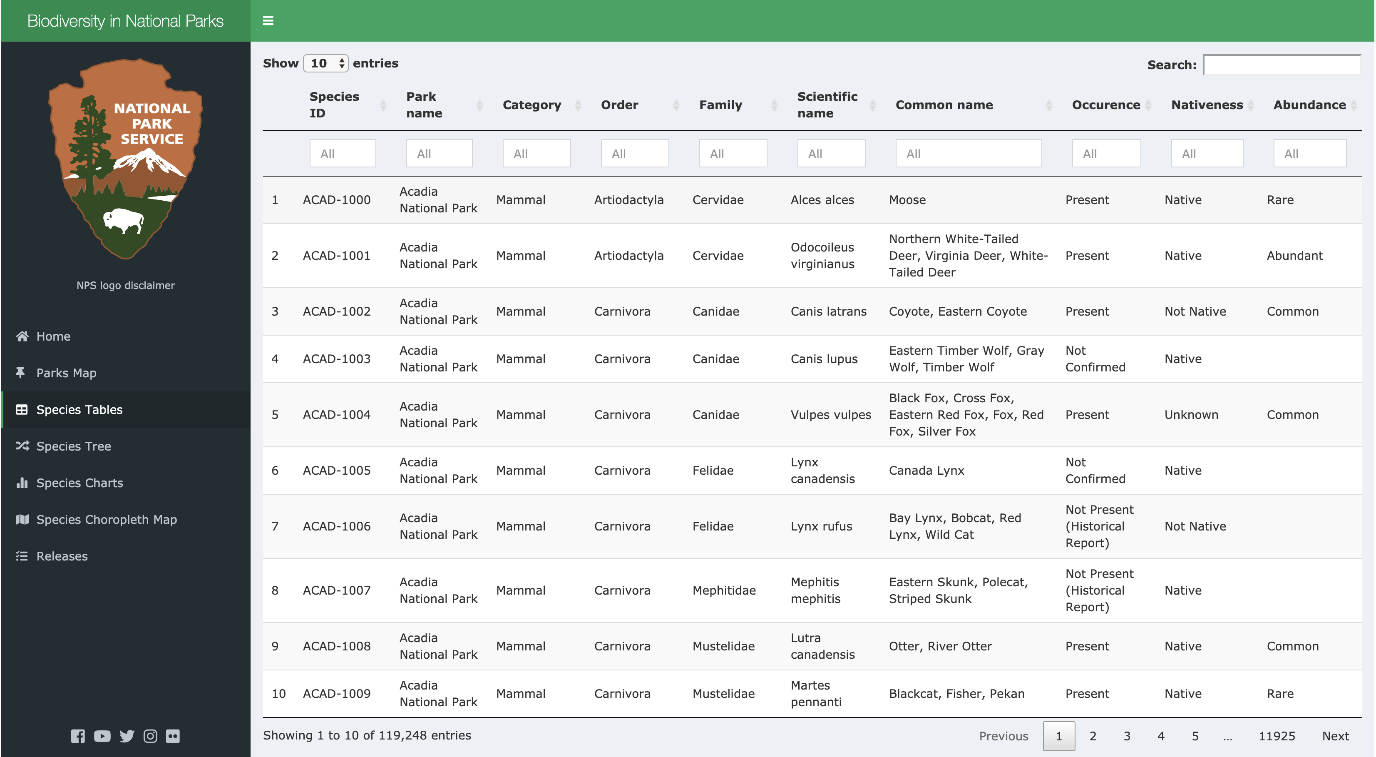
Reporting in R - Shiny
Shiny Gallery

Slide 7
Applications in NLP

